Slide 1

Chapter 6: Entity-Relationship Model
中国大学MOOC“数据库系统概论”
https://www.icourse163.org/learn/XDU-1002199005

Slide 2
Chapter 7: Entity-Relationship Model
Design Process
Modeling
Constraints
E-R Diagram
Design Issues
Weak Entity Sets
Extended E-R Features
Design of the Bank Database
Reduction to Relation Schemas
Database Design
UML

Slide 3
Design Phases
The initial phase of database design is to characterize fully the data needs of the prospective database users.
Next, the designer chooses a data model and, by applying the concepts of the chosen data model, translates these requirements into a conceptual schema of the database.
A fully developed conceptual schema also indicates the functional requirements of the enterprise. In a “specification of functional requirements”, users describe the kinds of operations (or transactions) that will be performed on the data.

Slide 4
Design Phases (Cont.)
The process of moving from an abstract data model to the implementation of the database proceeds in two final design phases.
Logical Design – Deciding on the database schema. Database design requires that we find a “good” collection of relation schemas.
  Business decision – What attributes should we record in the database?
  Computer Science decision – What relation schemas should we have and how should the attributes be distributed among the various relation schemas?
Physical Design – Deciding on the physical layout of the database

Slide 5
Design Approaches
Entity Relationship Model (covered in this chapter)
  Models an enterprise as a collection of entities and relationships
    Entity: a “thing” or “object” in the enterprise that is distinguishable from other objects
      Described by a set of attributes
    Relationship: an association among several entities
  Represented diagrammatically by an entity-relationship diagram
  Tools: MySQL Workbench, ProcessOn, Power Designer, Visio…
Normalization Theory (Chapter 7)
  Formalize what designs are bad, and test for them

Slide 6
Outline of the ER Model

Slide 7
Modeling
A database can be modeled as:
  A collection of entities(实体)
  Relationship(联系) among entities.
An entity is an object that exists and is distinguishable from other objects.
Example: specific person, company, event, plant
Entities have attributes(属性)
Example: people have names and addresses

Slide 8
Entity Sets
An entity is an object that exists and is distinguishable from other objects.
  Example: specific person, company, event, plant
An entity set is a set of entities of the same type that share the same properties.
  Example: set of all persons, companies, trees, holidays
An entity is represented by a set of attributes; i.e., descriptive properties possessed by all members of an entity set.
  Example:
  instructor = (ID, name, street, city, salary )
  course= (course_id, title, credits)
A subset of the attributes form a primary key of the entity set; i.e., uniquely identifiying each member of the set.

Slide 9

Entity Sets -- instructor and student
instructor_ID instructor_name student-ID student_name

Slide 10
Relationship Sets
A relationship is an association among several entities
Example:
44553 (Peltier) advisor 22222 (Einstein)
student entity relationship set instructor entity
A relationship set is a mathematical relation among n ≥ 2 entities, each taken from entity sets
{(e₁, e₂, … e_{n}) | e₁ ∈ E₁, e₂ ∈ E₂, …, e_{n} ∈ E_{n}}
where (e₁, e₂, …, e_{n}) is a relationship
  Example:
  (44553,22222) ∈ advisor

Slide 11

Relationship Set advisor

Slide 12

Relationship Sets (Cont.)
An attribute can also be associated with a relationship set.
For instance, the advisor relationship set between entity sets instructor and student may have the attribute date which tracks when the student started being associated with the advisor

Slide 13
Degree of a Relationship Sets
Degree of a Relationship Set refers to number of entity sets that participate in a relationship set.
Relationship sets that involve two entity sets are binary (or degree two). Generally, most relationship sets are binary.
Relationship sets may involve more than two entity sets.
  E.g. Suppose employees of a bank may have jobs (responsibilities) at multiple branches, with different jobs at different branches. Then there is a ternary relationship set between entity sets employee, job and branch.
Relationships between more than two entity sets are rare.

Slide 14
Mapping Cardinality Constraints
Express the number of entities to which another entity can be associated via a relationship set.
Most useful in describing binary relationship sets.
For a binary relationship set the mapping cardinality must be one of the following types:
  One to one
  One to many
  Many to one
  Many to many

Slide 15

Mapping Cardinalities
One to one
One to many
Note: Some elements in A and B may not be mapped to any
elements in the other set

Slide 16

Mapping Cardinalities
Many to one
Many to many
Note: Some elements in A and B may not be mapped to any
elements in the other set

Slide 17
Attributes
Attribute types:
  Simple and composite attributes.
  Single-valued and multivalued attributes
    Example: multivalued attribute: phone_numbers
  Derived attributes
    Can be computed from other attributes
    Example: age, given date_of_birth
Domain – the set of permitted values for each attribute

Slide 18

Composite Attributes

Slide 19
E-R Diagrams

Slide 20

Entity Sets
Entities can be represented graphically as follows:
  Rectangles represent entity sets.
  Attributes listed inside entity rectangle
  Underline indicates primary key attributes

Slide 21

Relationship Sets
Diamonds represent relationship sets.

Slide 22

Relationship Sets with Attributes

Slide 23

Roles
Entity sets of a relationship need not be distinct
  Each occurrence of an entity set plays a “role” in the relationship
The labels “course_id” and “prereq_id” are called roles.

Slide 24

Cardinality Constraints
We express cardinality constraints by drawing either a directed line (→), signifying “one,” or an undirected line (—), signifying “many,” between the relationship set and the entity set.
One-to-one relationship between an instructor and a student :
  A student is associated with at most one instructor via the relationship advisor
  A student is associated with at most one department via stud_dept

Slide 25
One-to-Many Relationship
one-to-many relationship between an instructor and a student
  an instructor is associated with several (including 0) students via advisor
  a student is associated with at most one instructor via advisor,

Slide 26
Many-to-One Relationships
In a many-to-one relationship between an instructor and a student,
  an instructor is associated with at most one student via advisor,
  and a student is associated with several (including 0) instructors via advisor

Slide 27
Many-to-Many Relationship
In a many-to-many relationship between an instructor and a student,
  An instructor is associated with several (possibly 0) students via advisor
  A student is associated with several (possibly 0) instructors via advisor

Slide 28

Total and Partial Participation
Total participation (indicated by double line): every entity in the entity set participates in at least one relationship in the relationship set
  participation of student in advisor relation is total
    every student must have an associated instructor
Partial participation: some entities may not participate in any relationship in the relationship set
  Example: participation of instructor in advisor is partial

Slide 29

Notation for Expressing More Complex Constraints
A line may have an associated minimum and maximum cardinality, shown in the form l..h, where l is the minimum and h the maximum cardinality
  A minimum value of 1 indicates total participation.
  A maximum value of 1 indicates that the entity participates in at most one relationship
  A maximum value of * indicates no limit.
Instructor can advise 0 or more students. A student must have 1 advisor; cannot have multiple advisors

Slide 30

Notation to Express Entity with Complex Attributes

Slide 31
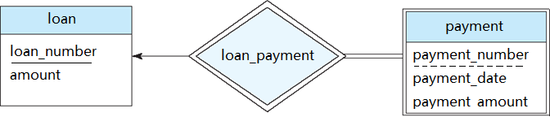
Weak Entity Sets
An entity set that does not have a primary key is referred to as a weak entity set (弱实体).
The existence of a weak entity set depends on the existence of a identifying entity set (strong entity, 标识实体，强实体).
  It must relate to the identifying entity set via a total, one-to-many relationship set from the identifying to the weak entity set

Slide 32
Weak Entity Sets
The discriminator (or partial key) of a weak entity set is the set of attributes that distinguishes among all the entities of a weak entity set.
The primary key of a weak entity set is formed by the primary key of the strong entity set on which the weak entity set is existence dependent, plus the weak entity set’s discriminator.

Slide 33
Weak Entity Sets
In E-R diagrams, a weak entity set is depicted via a double rectangle.
We underline the discriminator of a weak entity set with a dashed line.
The relationship set connecting the weak entity set to the identifying strong entity set is depicted by a double diamond.
Primary key for payment : (loan_number, payment_number)

Slide 34

Weak Entity Sets
Another example:
course is a strong entity and a section can be modeled as a weak entity
Primary key for section : (course_id, sec_id, semester, year)
If we model section as a strong entity we would model course_id as an attribute of section. Then the relationship with course would be implicit in the section attribute

Slide 35

E-R Diagram for a University Enterprise

Slide 36

E-R Diagrams (另一种画法)
Rectangles represent entity sets.
Diamonds represent relationship sets.
Lines link attributes to entity sets and entity sets to relationship sets.
Ellipses represent attributes
  Double ellipses represent multivalued attributes.
  Dashed ellipses denote derived attributes.
Underline indicates primary key attributes

Slide 37

E-R Diagrams (另一种画法)
E-R Diagram With Composite, Multivalued, and Derived Attributes

Slide 38


Slide 39
Reduction to Relation Schemas

Slide 40
Reduction to Relation Schemas
Entity sets and relationship sets can be expressed uniformly as relation schemas that represent the contents of the database.
A database which conforms to an E-R diagram can be represented by a collection of schemas.
For each entity set and relationship set there is a unique schema that is assigned the name of the corresponding entity set or relationship set.
Each schema has a number of columns (generally corresponding to attributes), which have unique names.

Slide 41
Representing Entity Sets
Each entity in an E-R diagram is mapped to a single table in a relational database.
  The columns of the table represent all the single-valued attributes that are attached to the entity;
  Composite attributes are flattened out by creating a separate attribute for each component attribute;
  A multivalued attribute M of an entity E is represented by a separate schema EM
  Derived attributes are not represent in the relational schema.

Slide 42
Representing Entity Sets
Relational Schema
  customer( customer-id, first-name, middle-initial, last-name, street-number, street-name, apartment-number, city,state, zip-code, date-of-birth )
  customer-phone( customer-id, phone-number)

Slide 43
Representing Entity Sets
A strong entity set reduces to a schema with the same attributes
course(course_id, title, credits)
A weak entity set becomes a table that includes a column for the primary key of the identifying strong entity set
section ( course_id, sec_id, semester, year )

Slide 44
Representing Relationship Sets
A many-to-many relationship set is represented as a schema with attributes for the primary keys of the two participating entity sets, and any descriptive attributes of the relationship set.
Example: schema for relationship set advisor
advisor = (instuctor_id, student_id)

Slide 45

Redundancy of Schemas
Many-to-one and one-to-many relationship sets that are total on the many-side can be represented by adding an extra attribute to the “many” side, containing the primary key of the “one” side
Example: Instead of creating a schema for relationship set inst_dept, add an attribute dept_name to the schema arising from entity set instructor

Slide 46
Redundancy of Schemas (Cont.)
For one-to-one relationship sets, either side can be chosen to act as the “many” side
  That is, an extra attribute can be added to either of the tables corresponding to the two entity sets
If participation is partial on the “many” side, replacing a schema by an extra attribute in the schema corresponding to the “many” side could result in null values

Slide 47
Redundancy of Schemas (Cont.)
The schema corresponding to a relationship set linking a weak entity set to its identifying strong entity set is redundant.
Example: The section schema already contains the attributes that would appear in the sec_course schema

Slide 48
Advanced Topics

Slide 49

Non-binary Relationship Sets
Most relationship sets are binary
There are occasions when it is more convenient to represent relationships as non-binary.

Slide 50

Ternary Relationship
Another example:
Suppose employees of a bank may have jobs (responsibilities) at multiple branches, with different jobs at different branches. Then there is a ternary relationship set between entity sets employee, job and branch.

Slide 51
Cardinality Constraints on Ternary Relationship
We allow at most one arrow out of a ternary (or greater degree) relationship to indicate a cardinality constraint
For example, an arrow from proj_guide to instructor indicates each student has at most one guide for a project

Slide 52
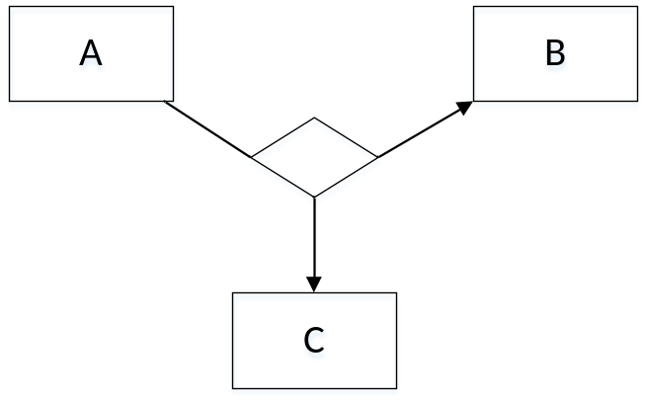
Cardinality Constraints on Ternary Relationship
If there is more than one arrow, there are two ways of defining the meaning
  For example, a ternary relationship R between A, B and C with arrows to B and C could mean
    1. Each A entity is associated with a unique entity from B and C or
    2. Each pair of entities from (A, B) is associated with a unique C entity, and each pair (A, C) is associated with a unique B
  To avoid confusion we outlaw more than one arrow

Slide 53
Representing Ternary Relationship
  Add a new scheme which include all primary keys of the three parts
  proj_guide (instuctor_id, student_id, project_id)

Slide 54
Specialization (特殊化)
Top-down design process; we designate sub-groupings within an entity set that are distinctive from other entities in the set.
These sub-groupings become lower-level entity sets that have attributes or participate in relationships that do not apply to the higher-level entity set.
Depicted by a triangle component labeled ISA (e.g., instructor “is a” person).
person
ISA
instructor

Slide 55

Specialization (特殊化)
Attribute inheritance – a lower-level entity set inherits all the attributes and relationship participation of the higher-level entity set to which it is linked.

Slide 56

Specialization Example
Overlapping – employee and student
Disjoint – instructor and secretary
Total and partial

Slide 57
Representing Specialization via Schemas
Method 1:
  Form a schema for the higher-level entity
  Form a schema for each lower-level entity set, include primary key of higher-level entity set and local attributes
  Drawback: getting information about, an employee requires accessing two relations, the one corresponding to the low-level schema and the one corresponding to the high-level schema
schema attributes
person name, street, city
customer name, credit-rating
employee name, salary

Slide 58
Representing Specialization as Schemas (Cont.)
Method 2:
  Form a schema for each entity set with all local and inherited attributes
  Drawback: name, street and city may be stored redundantly for people who are both customers and employees
schema attributes
person name, street, city
customer name, street, city, credit-rating
employee name, street, city, salary

Slide 59
Generalization
A bottom-up design process – combine a number of entity sets that share the same features into a higher-level entity set.
Specialization and generalization are simple inversions of each other; they are represented in an E-R diagram in the same way.
The terms specialization and generalization are used interchangeably.

Slide 60
Generalization
Can have multiple specializations of an entity set based on different features.
E.g. permanent-employee vs. temporary-employee, in addition to officer vs. secretary vs. teller
Each particular employee would be
  a member of one of permanent-employee or temporary-employee,
  and also a member of one of officer, secretary, or teller
The ISA relationship also referred to as superclass - subclass relationship

Slide 61

Design Constraints on a Specialization/Generalization
Completeness constraint -- specifies whether or not an entity in the higher-level entity set must belong to at least one of the lower-level entity sets within a generalization.
  total: an entity must belong to one of the lower-level entity sets
  partial: an entity need not belong to one of the lower-level entity sets
Partial generalization is the default. We can specify total generalization in an ER diagram by adding the keyword total in the diagram and drawing a dashed line from the keyword to the corresponding hollow arrow-head to which it applies

Slide 62

Aggregation
  Consider the ternary relationship proj_guide, which we saw earlier
  Suppose we want to record evaluations of a student by a guide on a project

Slide 63
Aggregation (Cont.)
Relationship sets eval_for and proj_guide represent overlapping information
  Every eval_for relationship corresponds to a proj_guide relationship
  However, some proj_guide relationships may not correspond to any eval_for relationships
    So we can’t discard the proj_guide relationship

Slide 64

Aggregation (Cont.)
Eliminate this redundancy via aggregation
  Treat relationship as an abstract entity
  Allows relationships between relationships
  Abstraction of relationship into new entity

Slide 65
Aggregation (Cont.)
Without introducing redundancy, the following diagram represents:
  A student is guided by a particular instructor on a particular project
  A student, instructor, project combination may have an associated evaluation

Slide 66
Representing Aggregation via Schemas
To represent aggregation, create a schema containing
  Primary key of the aggregated relationship,
  The primary key of the associated entity set
  Any descriptive attributes
In our example:
  The schema eval_for is:
  eval_for (student_ID, project_id, instructor_ID, evaluation_id, …)
  The schema proj_guide is redundant.

Slide 67
Design Issues

Slide 68

Entities vs. Attributes
Use of entity sets vs. attributes
Use of phone as an entity allows extra information about phone numbers (plus multiple phone numbers)
属性间不产生联系，当属性与其他实体有联系时，该属性应作为实体。

Slide 69

Entities vs. Relationship sets
Use of entity sets vs. relationship sets
Possible guideline is to designate a relationship set to describe an action that occurs between entities

Slide 70
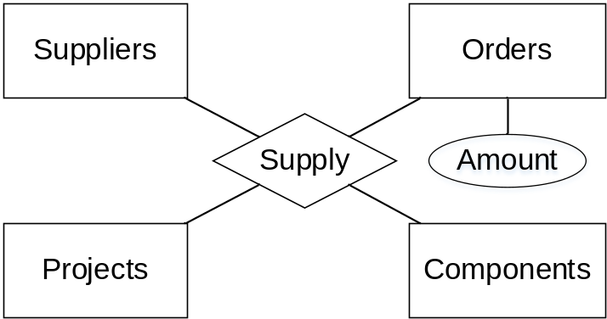
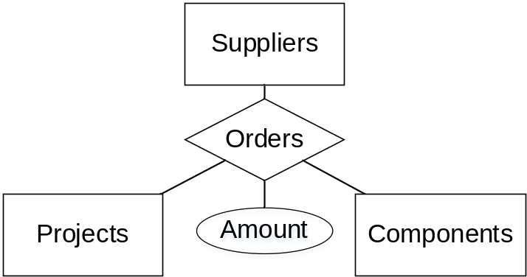
Entities vs. Relationship sets
Use of entity sets vs. relationship sets
Another example

Slide 71
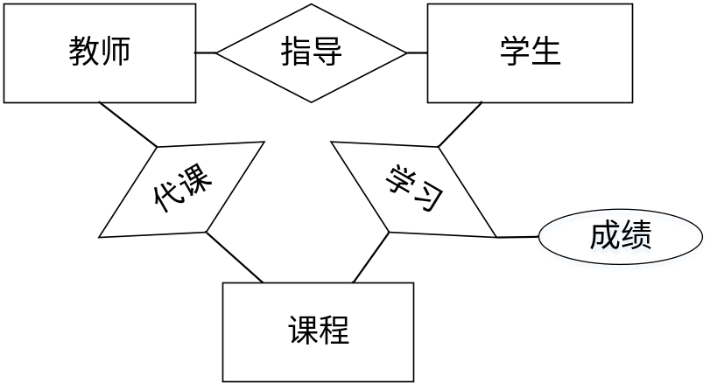
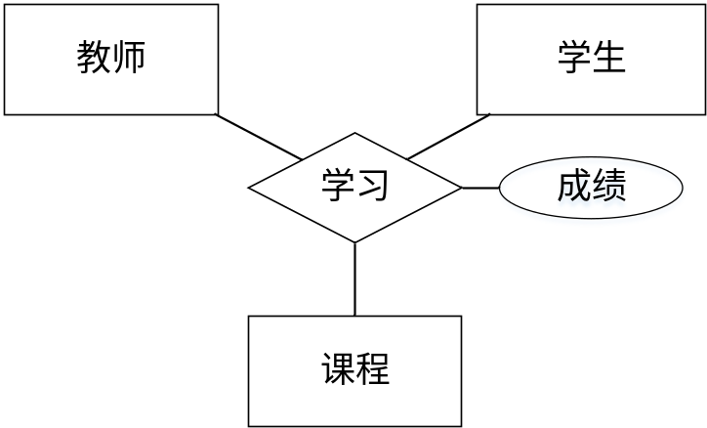
Binary Vs. Non-Binary Relationships
Although it is possible to replace any non-binary (n-ary, for n > 2) relationship set by a number of distinct binary relationship sets, a n-ary relationship set shows more clearly that several entities participate in a single relationship.

Slide 72
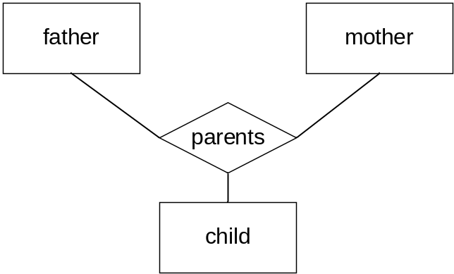
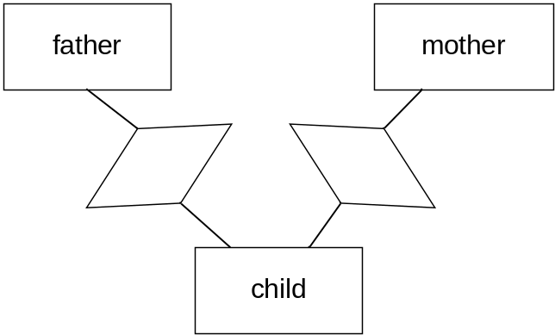
Binary Vs. Non-Binary Relationships
Some relationships that appear to be non-binary may be better represented using binary relationships
  For example, a ternary relationship parents, relating a child to his/her father and mother, is best replaced by two binary relationships, father and mother
    Using two binary relationships allows partial information (e.g., only mother being known)

Slide 73
Binary Vs. Non-Binary Relationships
  But there are some relationships that are naturally non-binary
    Example: proj_guide

Slide 74

Converting Non-Binary Relationships to Binary Form
In general, any non-binary relationship can be represented using binary relationships by creating an artificial entity set.
  Replace R between entity sets A, B and C by an entity set E, and three relationship sets:
1. R_{A}, relating E and A 2. R_{B}, relating E and B
3. R_{C}, relating E and C
  Create an identifying attribute for E and add any attributes of R to E
  For each relationship (a_{i} , b_{i} , c_{i}) in R, create
1. a new entity e_{i} in the entity set E 2. add (e_{i} , a_{i} ) to R_{A}
3. add (e_{i} , b_{i} ) to R_{B} 4. add (e_{i} , c_{i} ) to R_{C}

Slide 75
Converting Non-Binary Relationships (Cont.)
Also need to translate constraints
  Translating all constraints may not be possible
  There may be instances in the translated schema that
  cannot correspond to any instance of R
  We can avoid creating an identifying attribute by making E a weak entity set (described shortly) identified by the three relationship sets

Slide 76
Placement of relationship attributes
customer_name
customer_street
account_number
customer_id
customer_city
access_date
customer
0..N
depositor
1..1
account
one-to-many

Slide 77
Placement of relationship attributes
customer_name
customer_street
account_number
customer_id
customer_city
customer
0..N
depositor
1..N
account
access_date
many-to-many

Slide 78
E-R Design Decisions
The use of an attribute or entity set to represent an object.
Whether a real-world concept is best expressed by an entity set or a relationship set.
The use of a ternary relationship versus a pair of binary relationships.
The use of a strong or weak entity set.
The use of specialization/generalization – contributes to modularity in the design.
The use of aggregation – can treat the aggregate entity set as a single unit without concern for the details of its internal structure.

Slide 79
Summary of Symbols Used in E-R Notation

Slide 80
Symbols Used in E-R Notation (Cont.)

Slide 81

Alternative ER Notations
Chen, IDE1FX, …

Slide 82
Alternative ER Notations
Chen IDE1FX (Crows feet notation)

Slide 83
UML
UML: Unified Modeling Language
UML has many components to graphically model different aspects of an entire software system
UML Class Diagrams correspond to E-R Diagram, but several differences.

Slide 84

ER vs. UML Class Diagrams
*Note reversal of position in cardinality constraint depiction

Slide 85
ER vs. UML Class Diagrams
ER Diagram Notation
Equivalent in UML
*Generalization can use merged or separate arrows independent
of disjoint/overlapping

Slide 86
UML Class Diagrams (Cont.)
Binary relationship sets are represented in UML by just drawing a line connecting the entity sets. The relationship set name is written adjacent to the line.
The role played by an entity set in a relationship set may also be specified by writing the role name on the line, adjacent to the entity set.
The relationship set name may alternatively be written in a box, along with attributes of the relationship set, and the box is connected, using a dotted line, to the line depicting the relationship set.

Slide 87
作业4
某医院为了规范人员、财务、药品等的日常管理，决定采用数据库技术实现医院信息系统。现负责人提出要求如下：
  医院有若干个科室，科室信息有科室编号，科室名称，楼层等；
  医院药品信息有药品名称，厂商，售价等；
  医生有统一的编号、姓名、性别、职称等信息，并属于某一个科室，门诊时间由医院统一安排；
  病人看病时选择科室、医生进行挂号，医生根据病情开具处方，处方具体包含病人姓名，年龄，性别，日期，药品清单。
根据以上需求，完成该医院信息系统的设计及编程：
  画出系统的完整E-R图；
  将你的E-R图转换为关系模式
P₃₁₆ 7.3 , 7.20

Slide 88
End of Chapter 6

